Slide 1
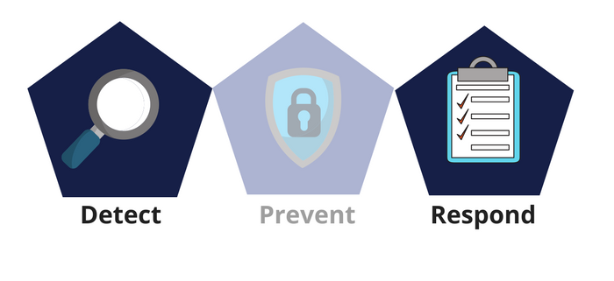



Network Security
Class IX
lab 27

Slide 2


Types of Hacking
Website Hacking

Slide 3

Types of Hacking
Network Hacking

Slide 4

Types of Hacking
Email Hacking

Slide 5

Types of Hacking
Ethical Hacking

Slide 6

Types of Hacking
Computer Hacking

Slide 7
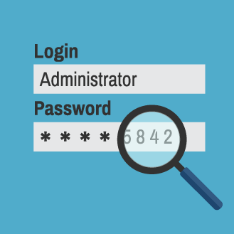
Types of Hacking
Password Hacking

Slide 8
Advantages of Hacking
To recover lost information
To perform penetration testing
To put adequate preventative measures in place to prevent security breaches.
To have a computer system that prevents malicious hackers from gaining access.

Slide 9
Tools for Ethical Hacking
1.NMAP
2.Metasploit
3.Burp Suit
4.Angry IP Scanner
5.Cain & Abel
6.Ettercap
7.EtherPeek
8.SuperScan
9.QualysGuard
10.WebInspect
11.LC4
12.LANguard Network Security Scanner
13.Network Stumbler
14.ToneLoc

Slide 10
Thank You

